Slide 1
European Commission’s own initiatives for promotion
Meeting of the Agri-food Promotion Committee of Trade Promotion Europe, 25 May 2023
Pawel Bienkowski, Programme Manager, Promotion of Agricultural Products, DG Agriculture & Rural Development, European Commission

Slide 2
Contents
EU pavilions
Promotion seminars
High Level Missions
Promotion campaigns
Market Entry Handbooks

Slide 3
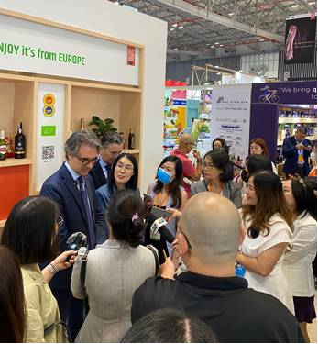
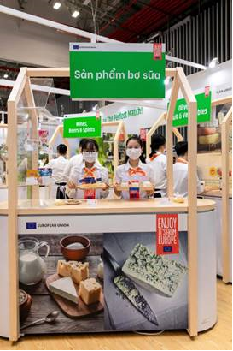
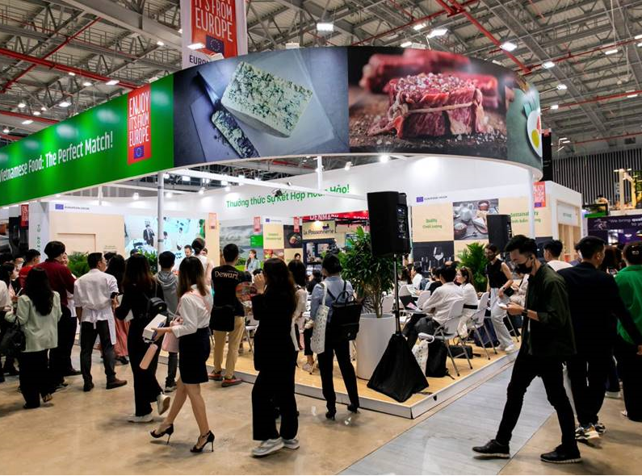
EU pavilion: Food & Hotel Vietnam 2022
FHV Vietnam 7-9 December 2022
EU umbrella visibility for MS pavilions and promo programmes
234 different products from 27 MS
9.444 visitors on stand
752 participants at cooking shows
7.758 samples @ tasting stations
Scheduled interviews with 5 media

Slide 4
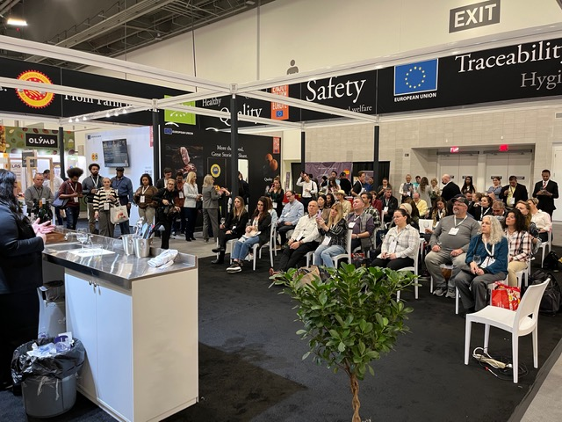
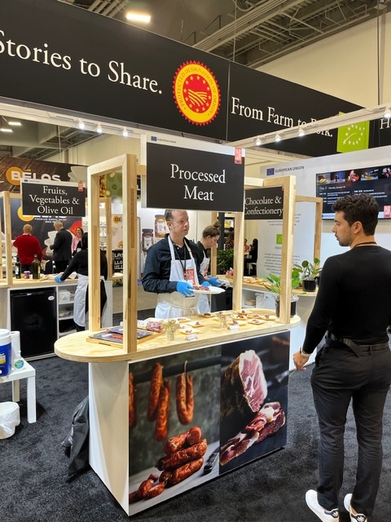
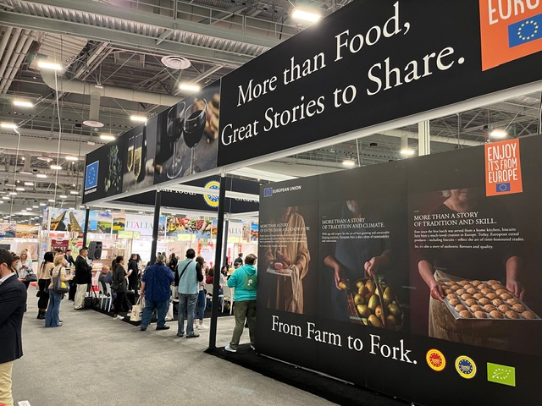
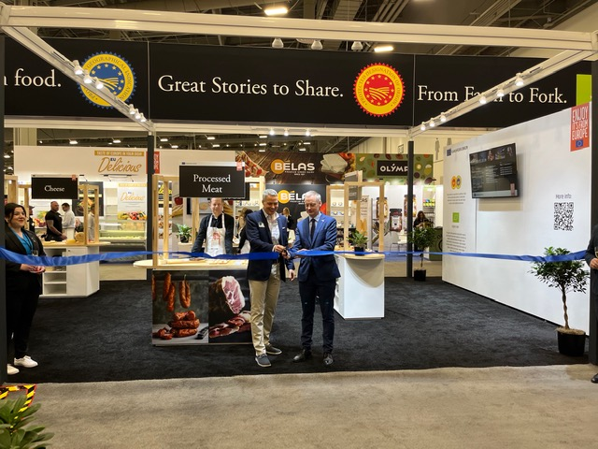
EU pavilion: Winter Fancy Food Show 2023
Las Vegas, USA, 15-17 Jan 2023
Enhanced cooperation with other EU exhibitors: product workshops, 17 participants
EU visibility umbrella at the fair
+/-4300 samples distributed
406 people attended the activities
+/- 2500 visited the tasting station area.

Slide 5
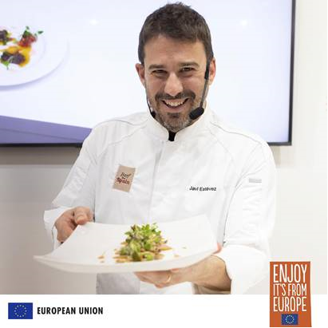
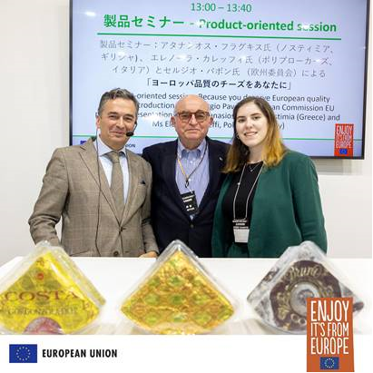
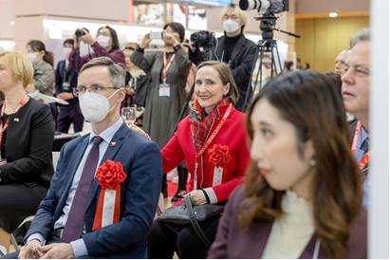
EU pavilion: Foodex Japan 2023
Tokyo 2023, 7-10 March 2023
23580 visitors on stand
580 participants at cooking shows/product-oriented sessions, pairing workshops,…
Speakers from MS pavilions and EU co-financed programmes
18119 samples @ tasting stations
4 Media interviews: 2 national TV stations
Your feedback?

Slide 6
Upcoming EU pavilions
Remaining EU pavilions TBC in 2024: China, Singapore, Mexico, Brazil
17–20 Sep. 2023
Foodex Saudi (replacing Gulfood)
8–10 Nov. 2023
FHC Shanghai
7–9 Dec. 2023
SIAL India
5-8 March 2024
Foodex Tokyo

Slide 7
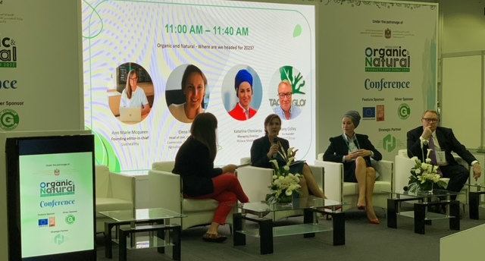
Promotion seminar for GCC countries
Dubai, UAE, 13-14 December 2022
80 participants, incl. 16 reps of authorities from the UAE, Bahrain, Oman and the GCC Standardization Organization (GSO)
Special focus on meat products (halal), dairy, fruit & vegetables, olive oil
Presentation and EU cooking show at “Organic & Natural” fair, 13 December
EU F&B Caravan, 5-18 December

Slide 8
Upcoming promotion seminar: Thailand
Bangkok, 7-8 June 2023
Physical format
Market access in Thailand remains still limited for some EU exports of plant and animal products
2 days/2 target audiences:
Day 1: competent authorities
Day 2: B2B professionals/importers/cooking schools
Workshops, cooking shows, bilaterals

Slide 9
High Level Mission to Japan: 2-6 July 2023
BUSINESS PROGRAMME
Day 1: Market intelligence seminar: importation rules, retail & distribution channels, consumer profiles & trends, finding a business partner etc. + official dinner
Day 2: Retail and site visits + B2B matchmaking
Day 3: Seminar on Osaka business environment + B2B matchmaking + visits
74 delegates from 22 MS
60% SMEs, 2/3 newcomers, 45% GIs/organic producers
Sectors: W&S, Meat, F&V, processed products, dairy, olive oil, beverage
Political programme of the Commissioner: market access issues

Slide 10
High Level Mission to India: 6-12 Dec 2023
HLM in combination with EU pavilion at SIAL Delhi (7-9 Dec 2023) and Mumbai (10-12 Dec 2023)
Objective: Business delegation of up to 70 businesspeople. Invitations out!
BD’s represent umbrella/sectoral organisations and companies from MS representing sectors with the highest potential given the difficult market access barriers (different per state).
Dairy, Pork, Poultry, Fruits and Vegetables, Wines, alcohol and spirits, Olive oil and vegetable oils, Chocolate, confectionery and bakery, grains, oilseeds, animal feed etc.
GI producers

Slide 11
Campaign in China: Irresistible Europe, Countless combinations
Started in January 2023 for 3 years
Target audiences: Affluent, middle-class consumers (repeated buyers), businesses, specialized media and opinion leaders
Campaign strategy: to incorporate EU F&B products as part of a daily Chinese diet. To compete for a permanent share of the pantry.
85% of activities online, 70% of budget for advertisement
Messages to continue reassuring about safety, quality of EU products

Slide 12
Campaign in China: Irresistible Europe, Countless combinations
Activities
Delivery boxes
Social media: “The Irresistible Swap” recipes, morning and weekend posts
Serious game
Quarterly post on all EU promotion activities in China, incl. promotion programmes
Events: hotels/horeca menu promotion, B2C & media e-commerce activation
New website, new XiaoHongShu, Bili-Bili accounts

Slide 13
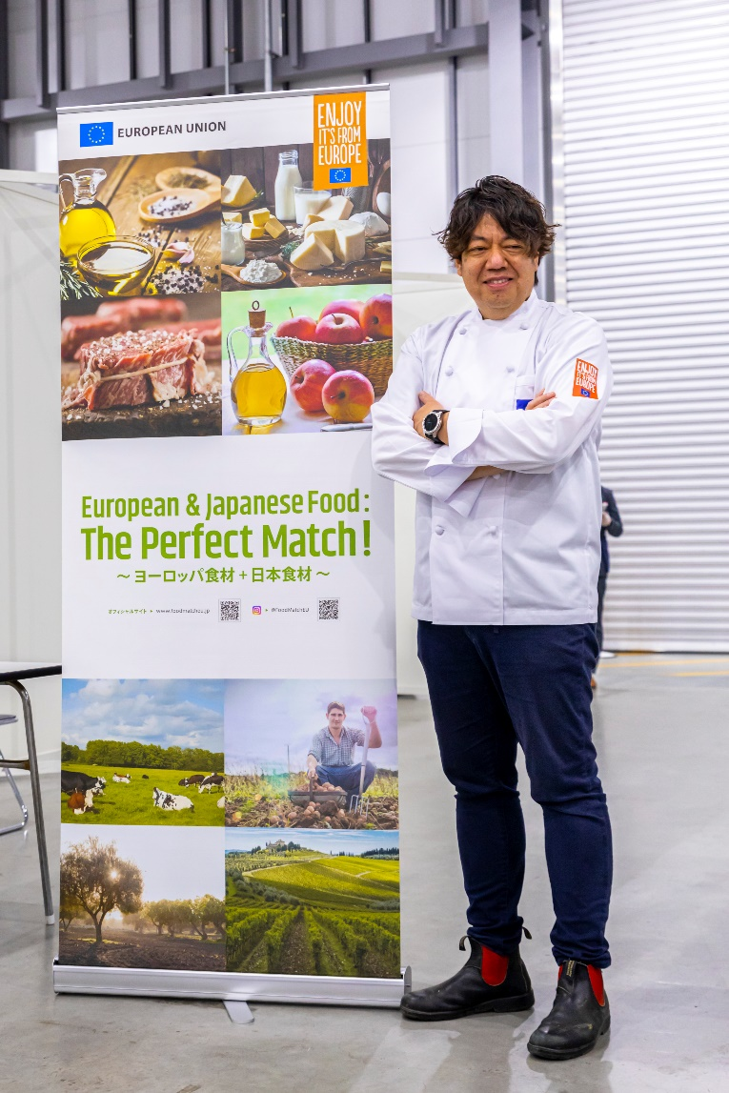
Campaign in Japan: Perfect Match
Started in March 2023 for 3 years
Target audiences: Affluent, middle-class consumers, businesses, specialized media and opinion leaders
Educate JP target audiences about ways to incorporate EU F&B’s in their healthy balanced diet, craving for high quality treats.
B2B: GI seminar and workshops, B2C: supermarket activations, e-commerce with Rakuten, EU caravan, markets, SNS (TV, YouTube, Netflix, Tver, digital and traditional media…)

Slide 14
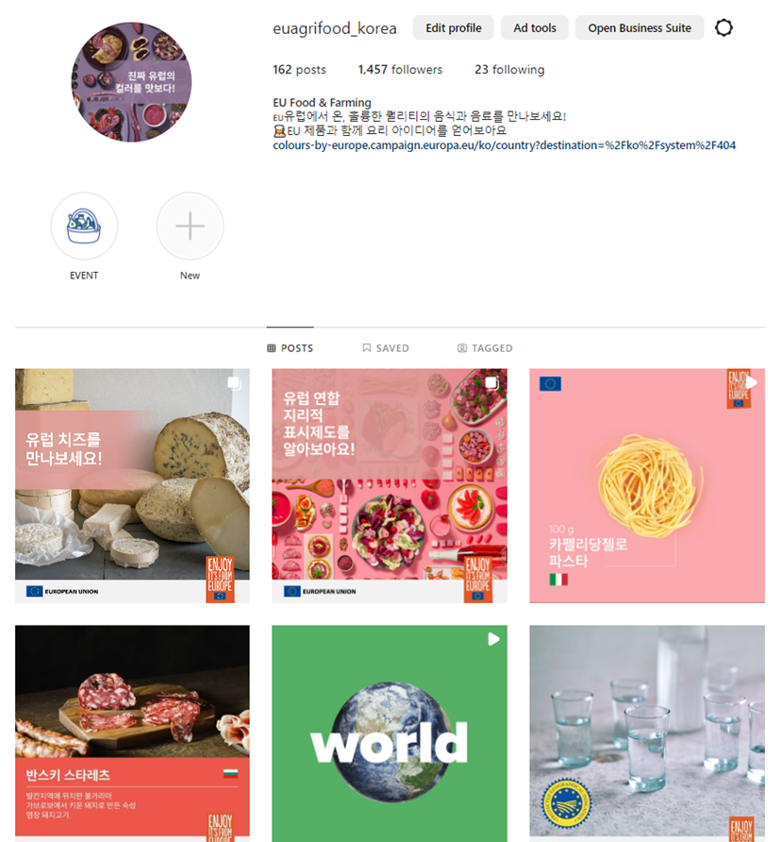
Campaign in South Korea: Colours by Europe, Tastes of Excellence
Duration: 3 years, started in March
Target audiences: Affluent, middle-class consumers, businesses, HORECA, specialized media and opinion leaders
B2B (Coex Food week and Seoul food) B2C activities (retail activations), SNS
Department store launch event with EU Ambassador on 24 June.
Objective: Increase awareness and knowledge of the excellence of EU agricultural products AND reinforce and popularise the image of “EU brand”, in the F&B sector of SK
Website: https://colours-by-europe.campaign.europa.eu/en
IG: https://www.instagram.com/euagrifood_korea/

Slide 15
Campaign in India: More than Food India
Duration: 3 years, start in June
Target audiences: Affluent, middle-class consumers, businesses, specialized media and opinion leaders
B2B and B2C activities (retail activations), support of HLM and SIAL Delhi

Slide 16
Upcoming new campaigns
United States
Expected start: Autumn 2023, 3 years
Product focus: quality cheeses, fresh/frozen/deli meats, olive oil, F&V preparations, confectionery, pasta & bakery, W&S and beers
Target audiences: Businesses (buyers, retailers, distributors, horeca), affluent, middle-class consumers, media and opinion leaders
United Kingdom
Expected start: late 2023 until end 2024
Product focus: fresh/frozen/deli meats, dairy and cheeses, fresh and frozen F&V, bakery products, confectionery, wine, spirits and beers
Special focus on organic, GI, sustainable, seasonal products
Targeting only B2B audience and specialised media

Slide 17
New Market Entry Handbooks
Newly produced: UK (new), Japan (update), Switzerland (new), Norway (new), Canada (update), Saudi Arabia (update)
https://rea.ec.europa.eu/funding-and-grants/promotion-agricultural-products-0_en
To be produced in 2023-24: India (update), Thailand (update), Brazil (new), Argentina (new), Australia (update), USA (update), China (update)

Slide 18
Thank you and Enjoy, it’s from Europe!

